Slide 1


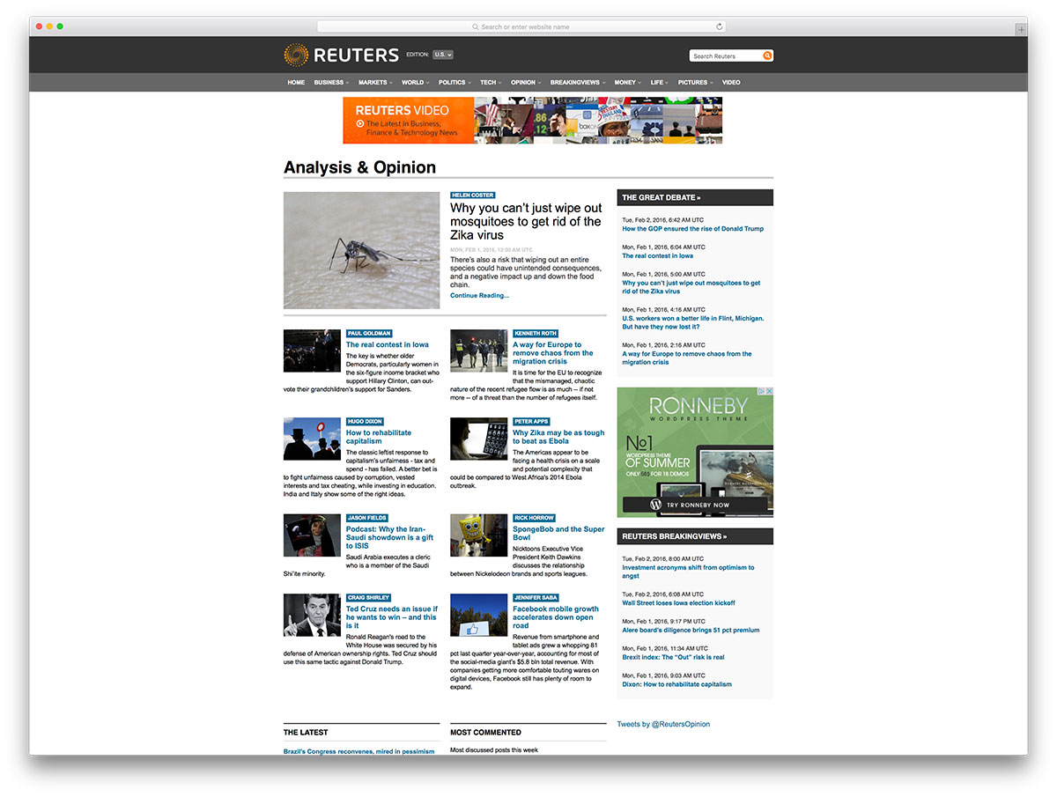

PUBLIC BLOGGING SYSTEM
-Using MERN stack development
A Major project
Submitted to P. B. Siddhartha College of Arts & Science for the partial fulfillment of the requirements for the award of
Degree of Bachelor Science (Bsc-CAMS)
By
G.RENUKA ( 203665)
Under the esteemed guidance of
Mrs V.Jhansi

Slide 2
Abstract:
Blogging is as simple as obtaining a website and publishing original content on it. Tech-savvy bloggers can buy a domain name and build the website themselves. Those with less HTML knowledge can create an account with sites like WordPress that simplify the web design and publishing process.Blogs are usually simple websites. Older pieces may be archived in separate sections of the site, and there may be a separate page with contact info or a bio, but the blog itself is usually just a single page that can be scrolled through—similar to the news feed on social media sites like Facebook. As with a Facebook news feed, a blog displays the newest content at the top of the page.
Another unique feature of blogging is interlinking. This occurs when a blogger links to another person's blog within their own blog post. For example, if a music teacher maintains a blog, and they write a blog post about how to form a chord, they might link to a musician's blog to show an example of the chords in action. A political blogger may link to another politics blog and then discuss how they agree or disagree with a post on that blog. Interlinking, along with the comment section, fosters the sense of community that makes blogs unique.The purpose of online blogging system is to automate the existing manual syatem by the help of computarized equipments and full-fledged computer software, fulfilling their requirements, so that their valuabale data/information can be stored for a longer period of time with easy accessing and manipulation of the same. The required software and hardware are easily availbale and easy to work with.A blog, short for weblog, is a frequently updated web page used for personal commentary or business content. Blogs are often interactive and include sections at the bottom of individual blog posts where readers can leave comments.

Slide 3
ADVANTAGES:
1. You can manage your online identity and build trust
Both people and businesses have their information posted online. What happens then when someone searches your name? One of the advantages of blogs is that it allows you to build and to control your online identity.
Aside from social network profiles, people who are searching for your name can find your blog or your author page on other blogs. That information will help people to get to know you better by reading your work.
2. You will learn new things
You not only teach others when you blog. You learn as well. At first, you will learn more about your niche because you need to educate yourself to teach others.
You will also learn a lot about other fields, such as online marketing, no matter what you write.
Whether you like it or not, there’s a certain amount of marketing knowledge you will need to increase the traffic to your blog. Your knowledge of email marketing, search engine marketing, and social media marketing will continue to grow.
3. You will improve your writing skills
The more you do something, the better you will become at that skill. Writing is no exception. Even if you don’t set out to study writing, your writing will improve the more you do it.You can even invest in grammar checker tools, like Grammarly, to help you with the writing basics, punctuation, spelling, sentence structure, and style while you write.

Slide 4
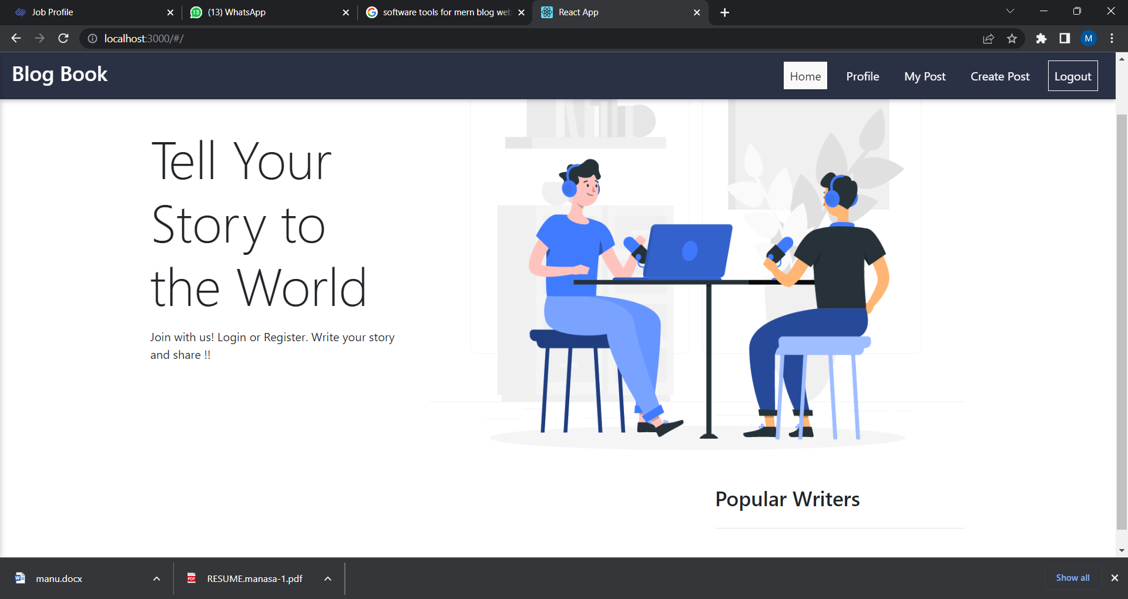
OUTPUT SCREEN OF OUR BLOG BOOK:

Slide 5
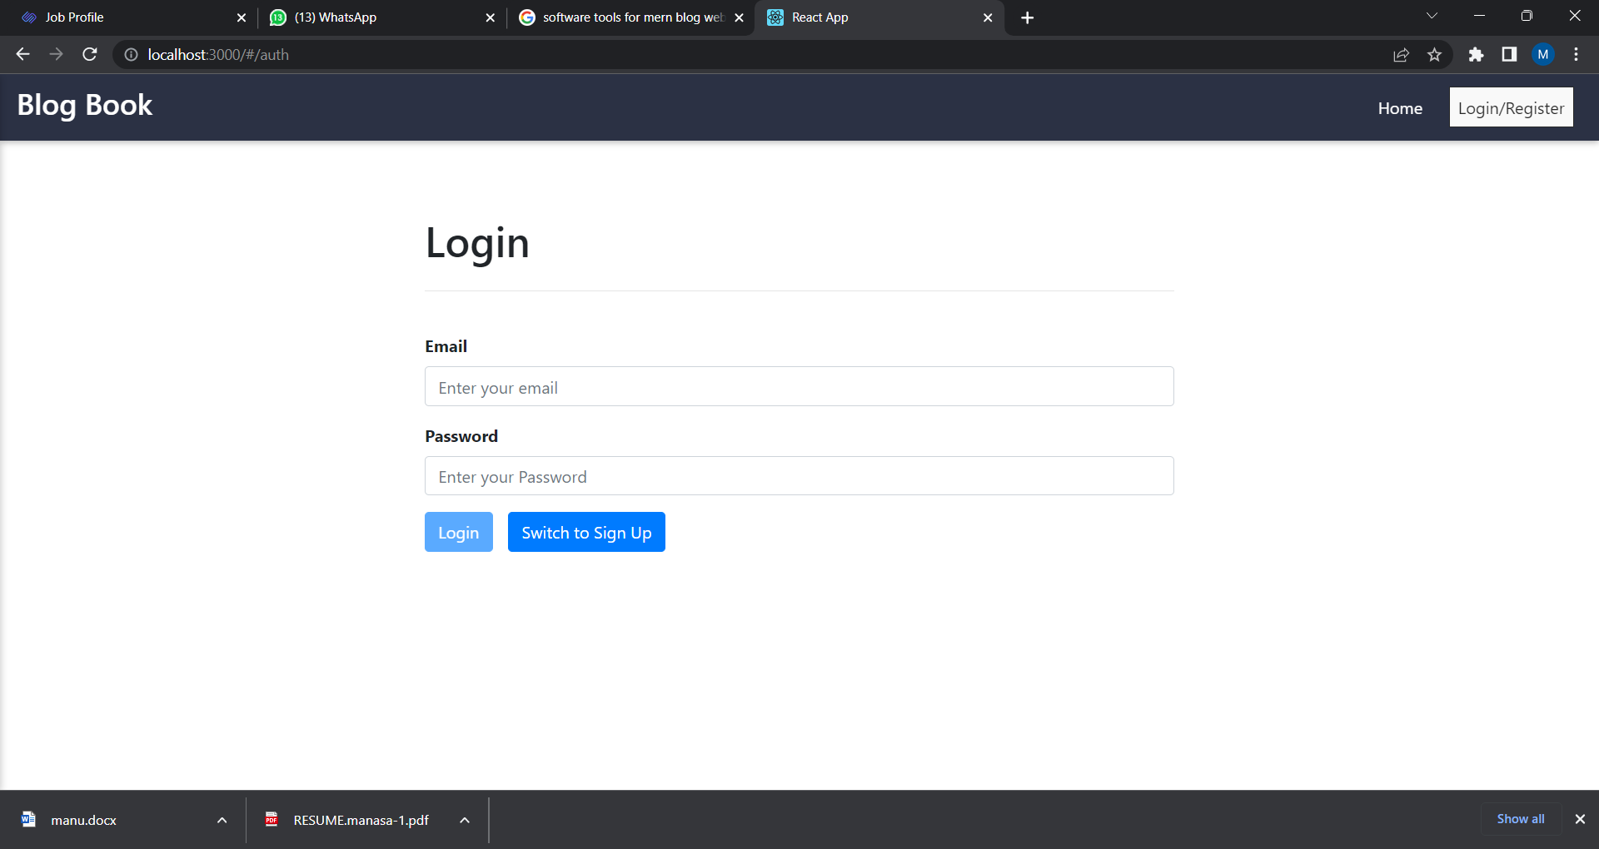
LOG IN/SIGN UP PAGE:

Slide 6
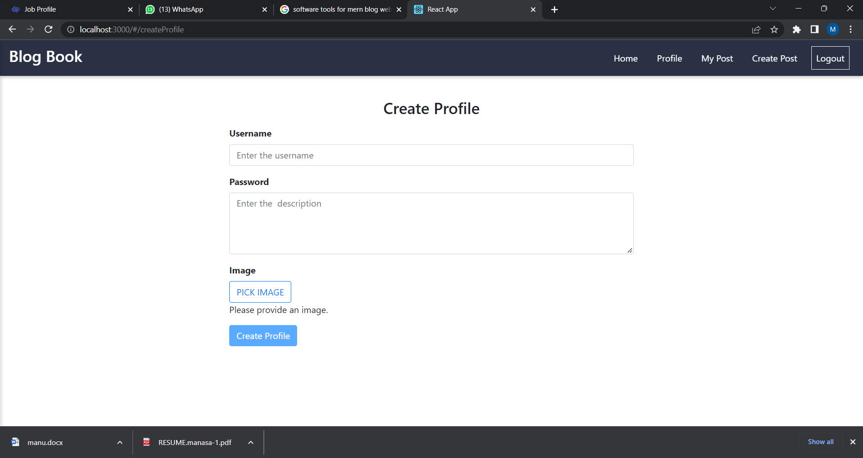
CREATE PROFILE OR CREATE POST:

Slide 7
SYSTEM ANALYSIS
Existing system:
There is an old and traditional system that is even followed even now,which is manual blog application system.Later on ,we started to use some tools like google documents and google sheets.Then came as previously said the biometric system of blog.Each had it owns purpose as the sole purpose off manufacturing something is to fullfill its purpose.
As far as considering the executing systems they have served their purpose to their full extent.
Proposed System:
The current system is what that proves the difference in technology and time.
As introduced earlier,this sytem captures the face and recongnizes them on comparing with the pictures in database.if there is a question of accuracy recognition ,it is achevied by continuous testing of the facial recognition system using sample data and the software used for that was Selenium IDE whichwe shall discuss in future.
NEED AND MOTIVATION:
Here’s a list of some of those things blogging can help with:
If you’re a business owner, it’s a great way to connect with customers. Forget Twitter, networking events, and call centers. Blogging is a personal, down-to-earth method of keeping your customers informed and in-the-know about not only your latest product offerings, but your internal culture as well.
Finding new clients. In the same vein, don’t discount the marketing advantages of blogging. If you do it right, you could be on to something. Many businesses chalk up a large percentage of their revenue from blogging and blogging-related activities, and you can have a piece of that pie.
Getting more done. Just because you’re writing every day on a blog doesn’t mean other things won’t get done. Blogging is an activity that can literally happen anywhere. Wake up early, go to bed late, whatever–blogging doesn’t usually take long, and you can press writing that first sentence–you’ll find yourself invigorated, energized, and motivated by the words you’re writing.

Slide 8
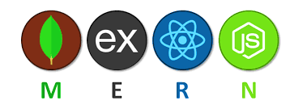
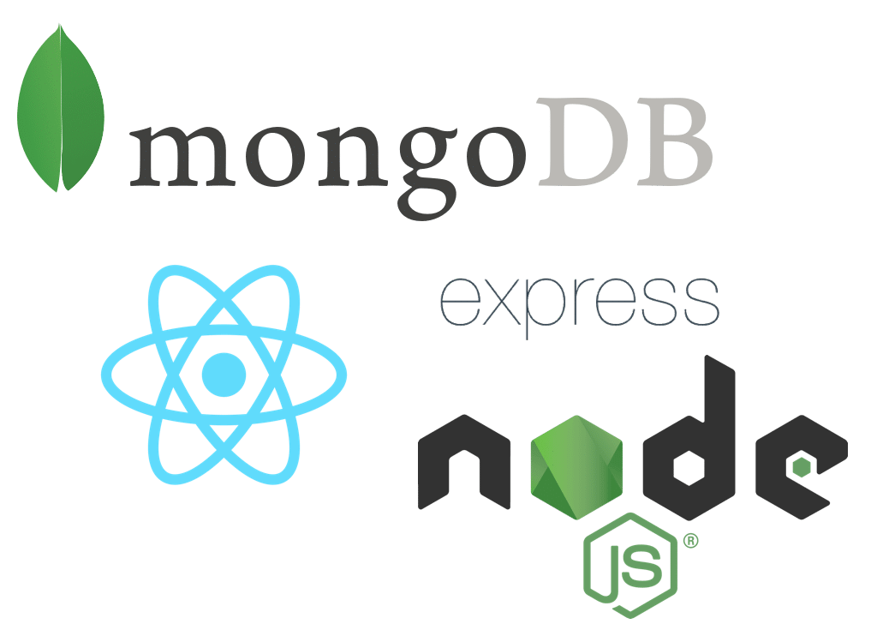
SYSTEM REQUIREMENTS:
Sublime text
Github
Backend-Express,Node.js,MongoDB
Frontend-Bootstrap,React,Java script,CSS

Slide 9
Let us understand what does MERN stack means:
Mongo DB – It’s an open-source NoSQL cross-platform document-oriented database.
Express JS – It’s a web-based application framework work with Node JS, It helps to build web apps and RESTful APIs.
React– React is a JavaScript library created by Facebook. React is a User Interface (UI) library. React is a tool for building UI components
Node JS – It is a free JavaScript run-time environment, It executes JavaScript code outside of a browser. It is available for macOS, Windows, Linux, and Unix.
Install and Configure required NPM packages for MERN Stack app development:
Use the below command to install the following node modules.
npm install --save body-parser cors express mongoose
Body-parser: The body-parser npm module is a JSON parsing middleware. It helps to parse the JSON data, plain text, or a whole object.
CORS: This is a Node JS package, also known as the express js middleware. It allows enabling CORS with multiple options. It is available through the npm registry.
Express.js: Express js is a free open source Node js web application framework. It helps in creating web applications and RESTful APIs and act as middleware
Mongoose: Mongoose is a MongoDB ODM for Node. It allows you to interact with the MongoDB database.
Starting and stopping a server every time a change is made is a time-consuming task. To get rid of this problem we use nodemon the npm module. This package restarts the server automatically every time we make a change. We’ll be installing it locally by using the given below command.

Slide 10
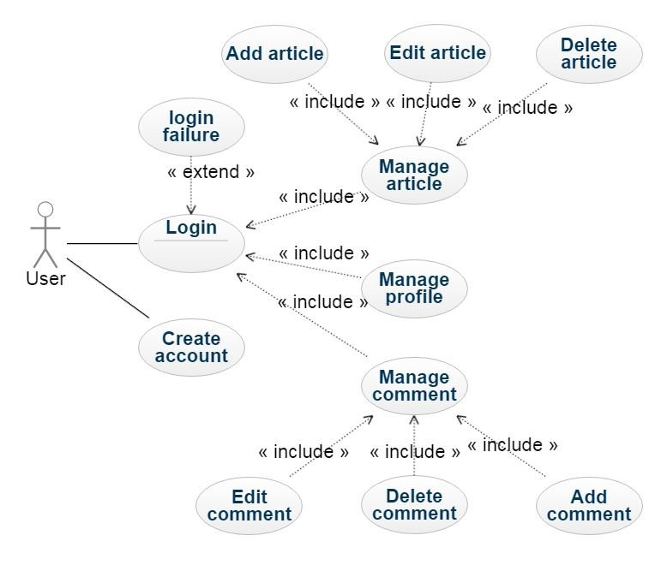
USECASE DIAGRAM:

Slide 11
Conclusion
With the MERN stack you can ideally build any web application you want by learning just one language, Javascript. With increased popularity of NoSQL databases, MongoDB is a go to database because of its scalability and flexible document schemas.
Though, the MERN stack is ideally suited for more JSON heavy, cloud native and dynamic web applications. One can build simple applications like the todo list, task manager to more complex ones like e-commerce sites and social media sites. MERN stack has growing popularity and many advantages with backing from a community of developers. If one aspires to be a full stack developer, he/she should definitely try out the MERN stack!
Finally, we are done for this MERN Stack Tutorial using React and Bootstrap 4. I have tried to highlight every essential topic in this tutorial. However, if you have skipped anything you can check out my Github Repo.

Slide 12


